Slide 1

An exploratory data analysis of Macau's third
city-wide nucleic acid testing
Adam Zheng

Slide 2


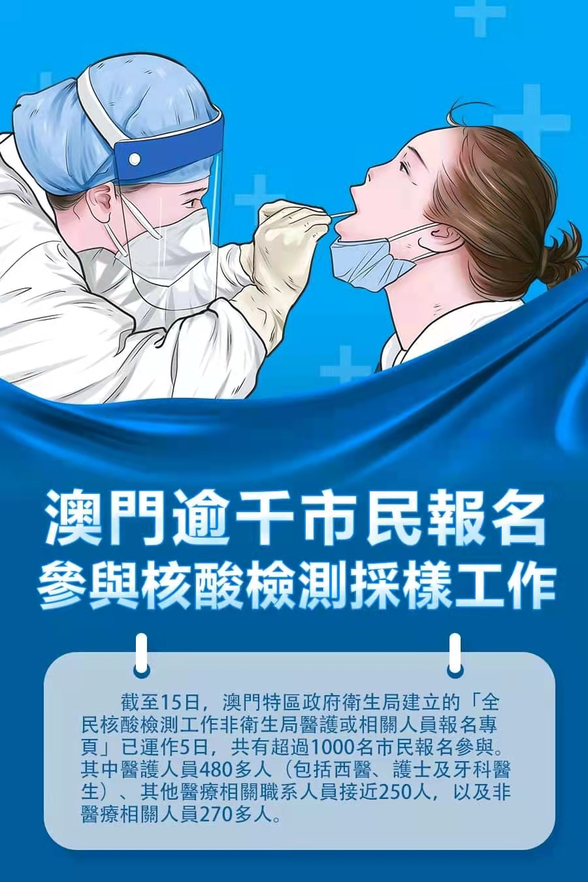
Background
Under COVID-19 pandemic in 2021, when new imported case has reported, Macau government the health bureau will launch 1 round of city-wide nucleic tests to prevent the corona-virus from spreading to local communities.
Notes:
EDA of Macau’s 3rd time city-wide NAT over October 4th 9pm - 7th 9pm, overall period is shortened, targeting to process for over 600k citizens within 48 hours. (There were 8 locations kept swab station working as usual for continuing after the first 48 hour)

Slide 3
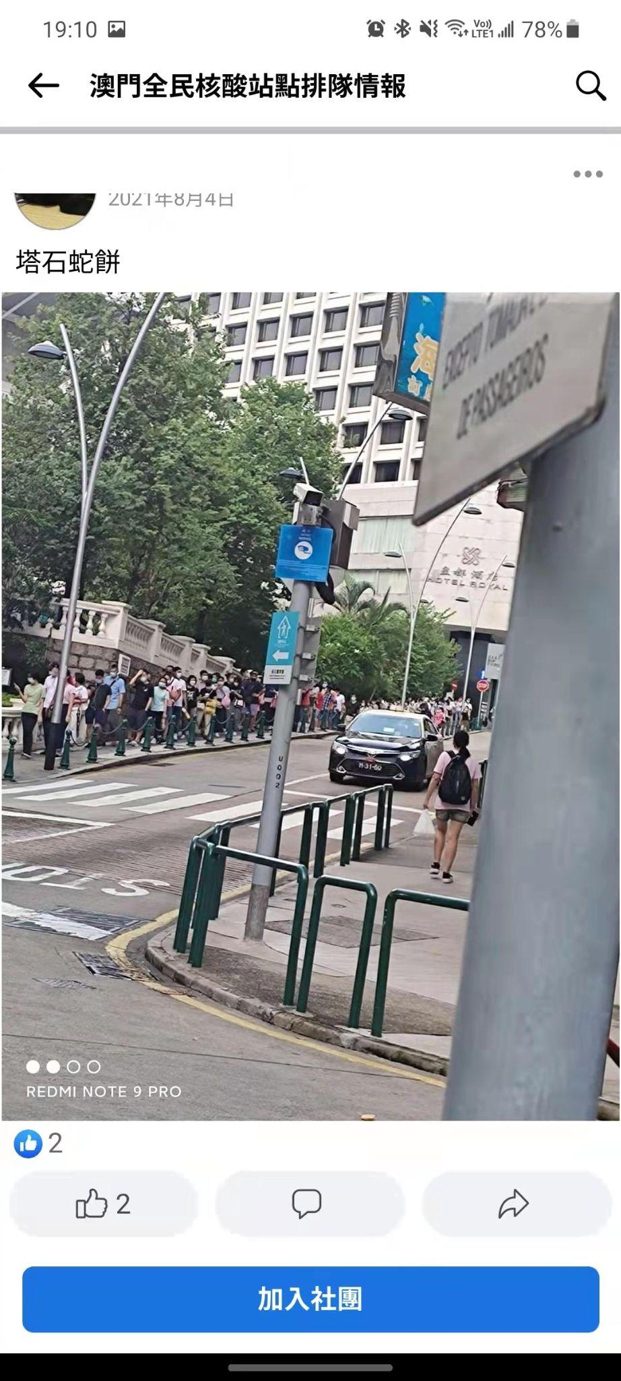
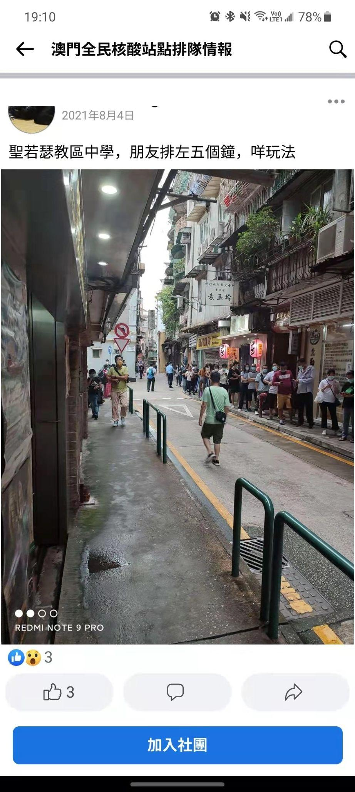
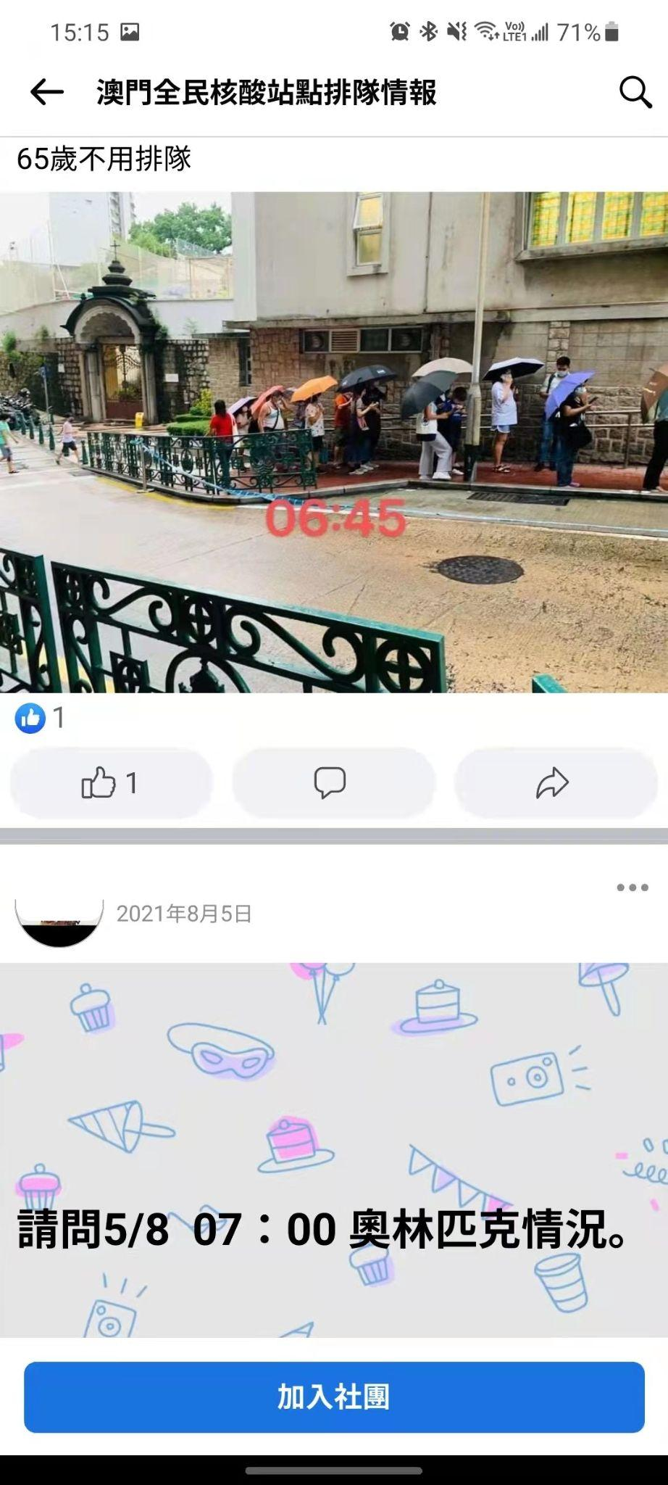
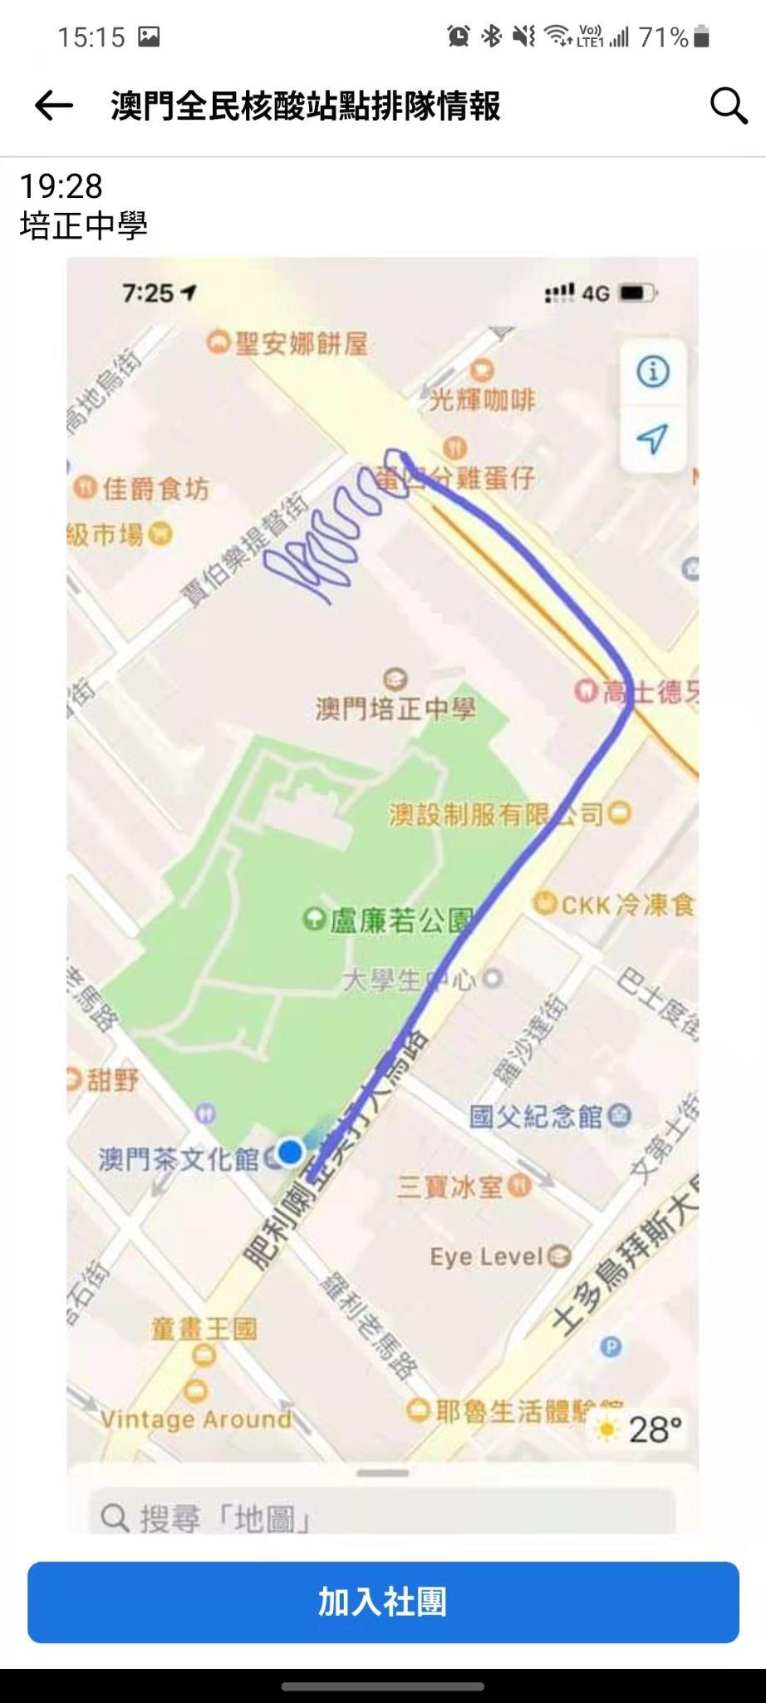
Problem with facts
- Which time ranges are the most busiest time during day? - If any location is over stressed or too free? - If overall performance is well balanced among each location?

Slide 4
Expected Maths Formula
Number of Swabs per 30 minutes
Nasal Swab Desks + Mouth Swab Desks
650，000 = Swab per desk × Swab Desks × Number of Locations × 48 hr
Swab per desk (speed) =

Slide 5
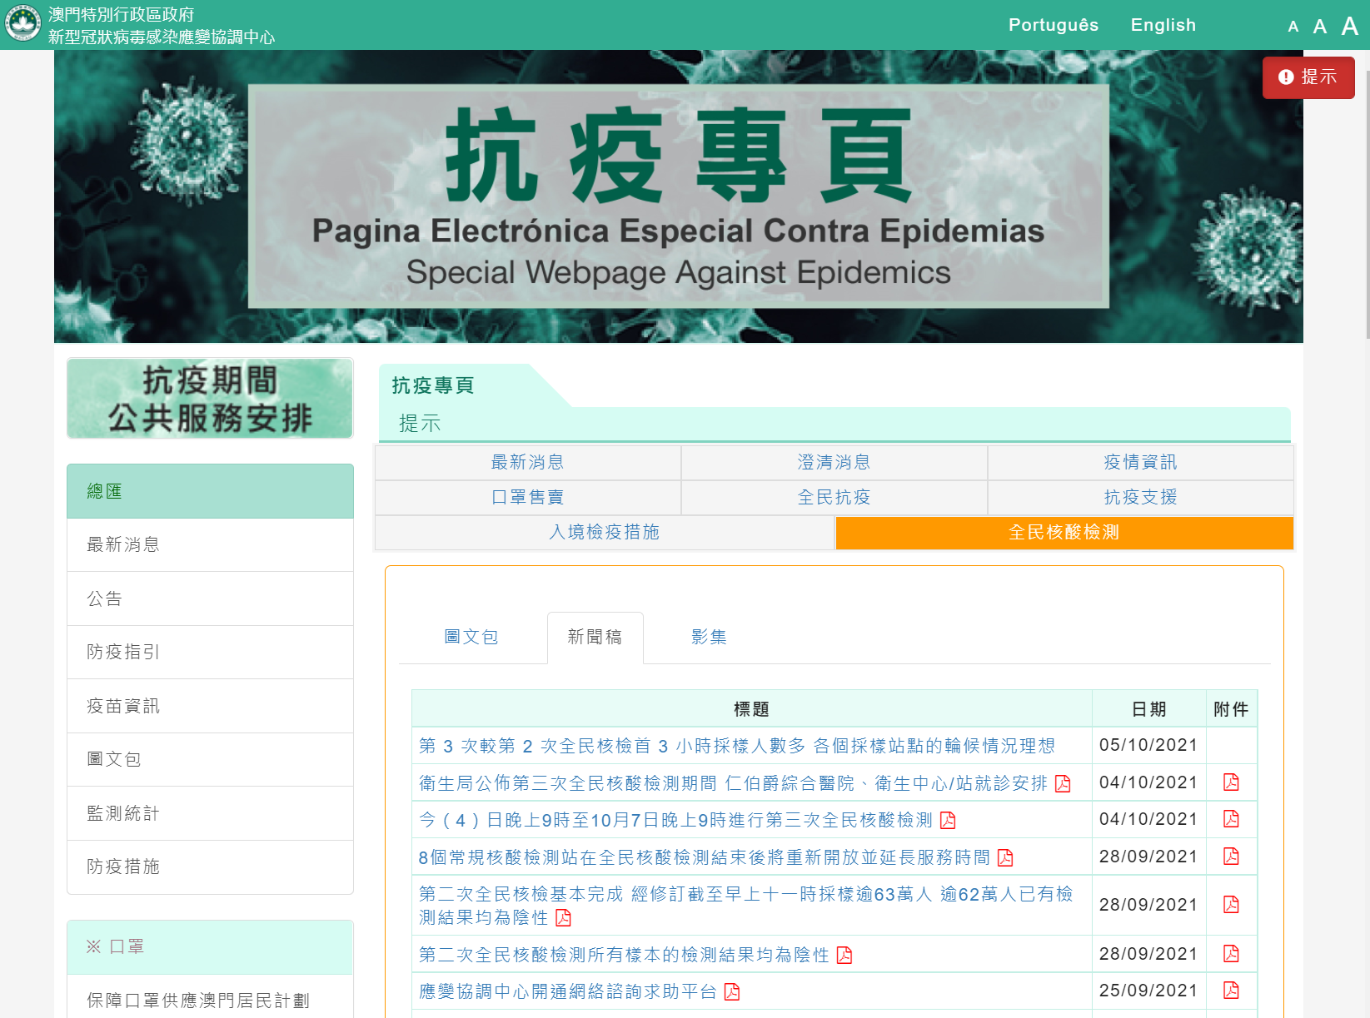
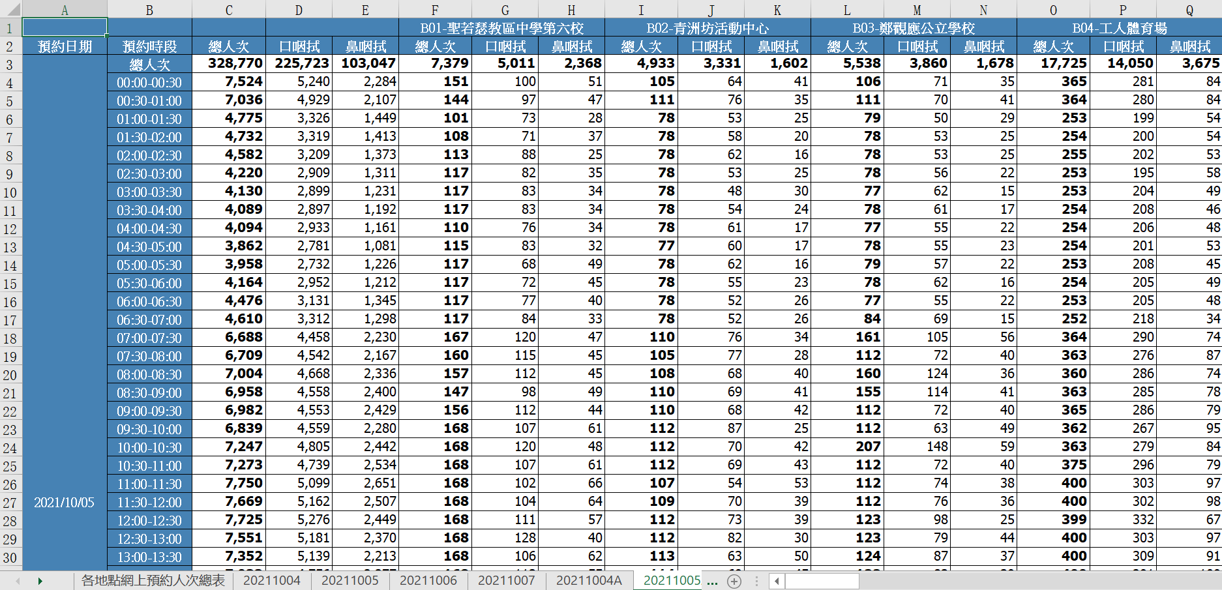
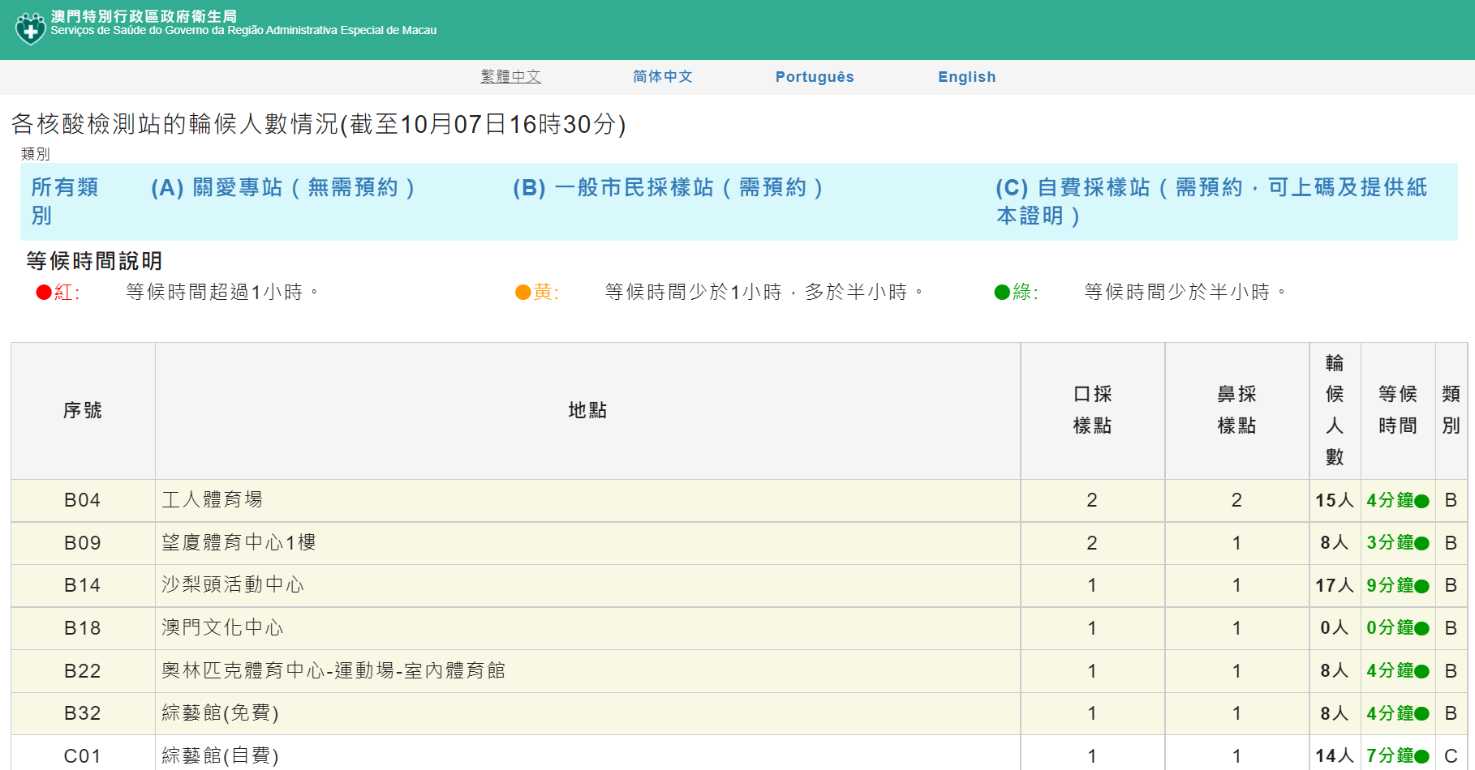
Data Wrangling
- City-wide Nucleic Acid Test Booking Stats - Excel - Special webpage against Epidemics - ( A near real-time waiting stats at each swab station location)
Notes:
- Source 1 only selects the latest record; from the specific 4 spreadsheets; - Source 2 is refreshed about every 10 minutes, web scraped by schedule; batch load and deduplicate per 30 minutes duration; backfill missing timeframes Oct-05 6am / 8:30 am / 9am; combine geolocation information;

Slide 6
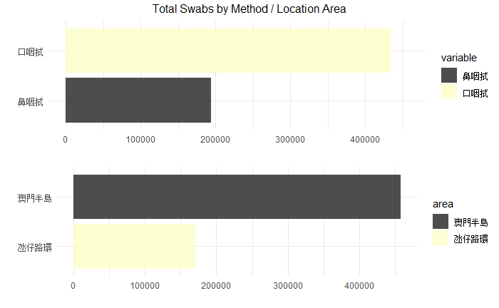
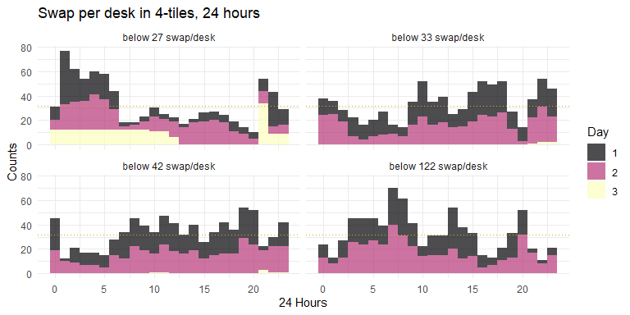
Preliminary Analysis - Ratios
- Total bookings is 627,865 (Category B - General stations) - In the 4th tile, 3 peaks appears by 7am / 1pm / 8pm, each shows more than 45 times, matched rush hour during a day - Consider to increase number of stations (swab desks) for the specific time frame
Notes:
The mouth swab total is about 2.3 times than nasal swab; Macau peninsula is about 2.8 times than Taipa;
Quartile based on number of swab per station; 1st tile most count overnight, and the 2nd and 3rd most appears by daytime;

Slide 7
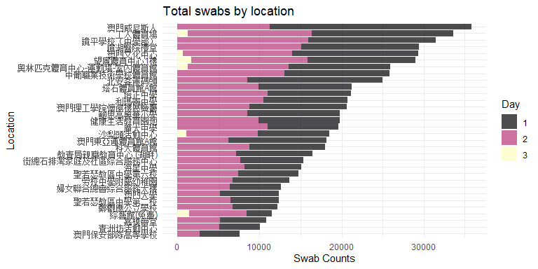
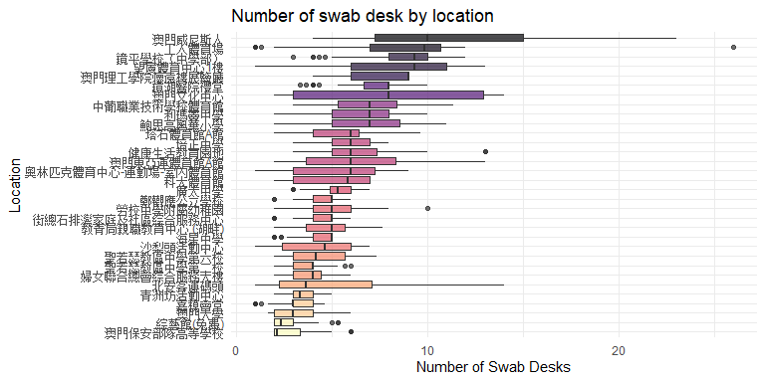
Preliminary Analysis - Locations
- The distribution tends to day 1 (first 24 hours) for locations in Taipa - Outlier for Worker Stadium, once increased from 10 to 23 - The adjustment down at Keang Peng Middle School, Kiang Wu Hospital Auditorium

Slide 8
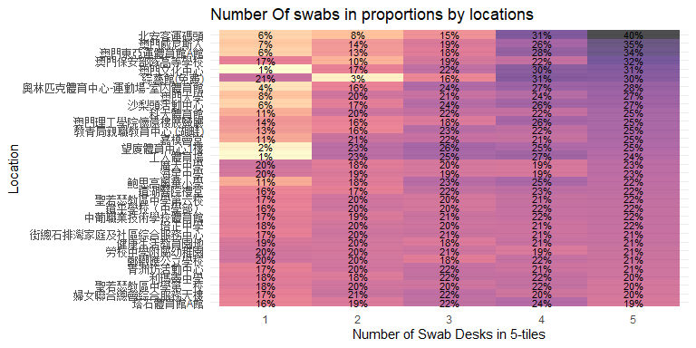
Preliminary Analysis - Locations
- Heatmap sorted by the 5th tile swab count by number of desks in proportions - Taipa most swabs were done at the 5th tile, when most number of stations available, e.g. Pac On Ferry Terminal, Venetian Cotai Arena, East Asian Games Dome

Slide 9
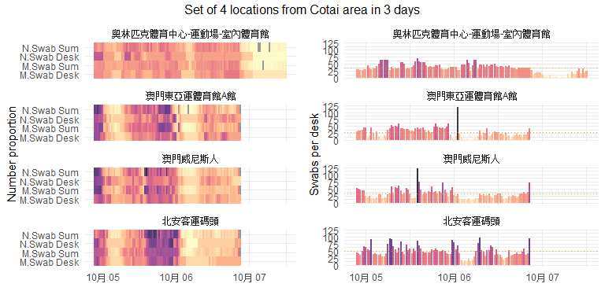
Resource Allocations - Taipa Stations
- There are dimmer and lighter intervals one after each in swab desks vs swab counts - The 2nd day overall has less stressed than the 1st in Taipa, shows why the distribution appears most tend to be in day 1, where most number of stations available - Spikes appears for Venetian Cotai Arena and East Asian Games Dome at different time
Notes:
- Consider supporting each other in due time - Consider for supporting Macau side, or make redirection for the crowd to comes Taipa by day 2

Slide 10
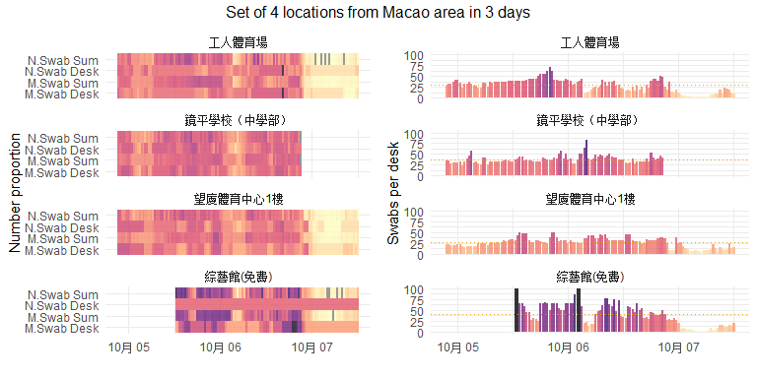
Resource Allocations - Macau Stations
- At Mong-Ha Sports Centre, Keang Peng Middle School, Worker Stadium, for both swab methods, adjustment to increase / decrease desks are settled well with swab counts - Macau Forum has fluctuated swab counts, but rarely has any adjustment in swab desks
Notes:
- Plan with the booking numbers in advance

Slide 11
A Dynamic Look To The Map
- Notable Peak times by the 10th and 16th hour (Oct-06 7am / 1pm) - The 31st -36th hour crowd appears only in Macau peninsula i.e. Taipa is relatively quiet (Oct-07 4am - 9am) - Last crowd appears right before the last hour (Oct-07 8pm)
Notes:
Animation set for the 4th quartile on swab per desk in 48 hours Bubble size representing swab per desk

Slide 12
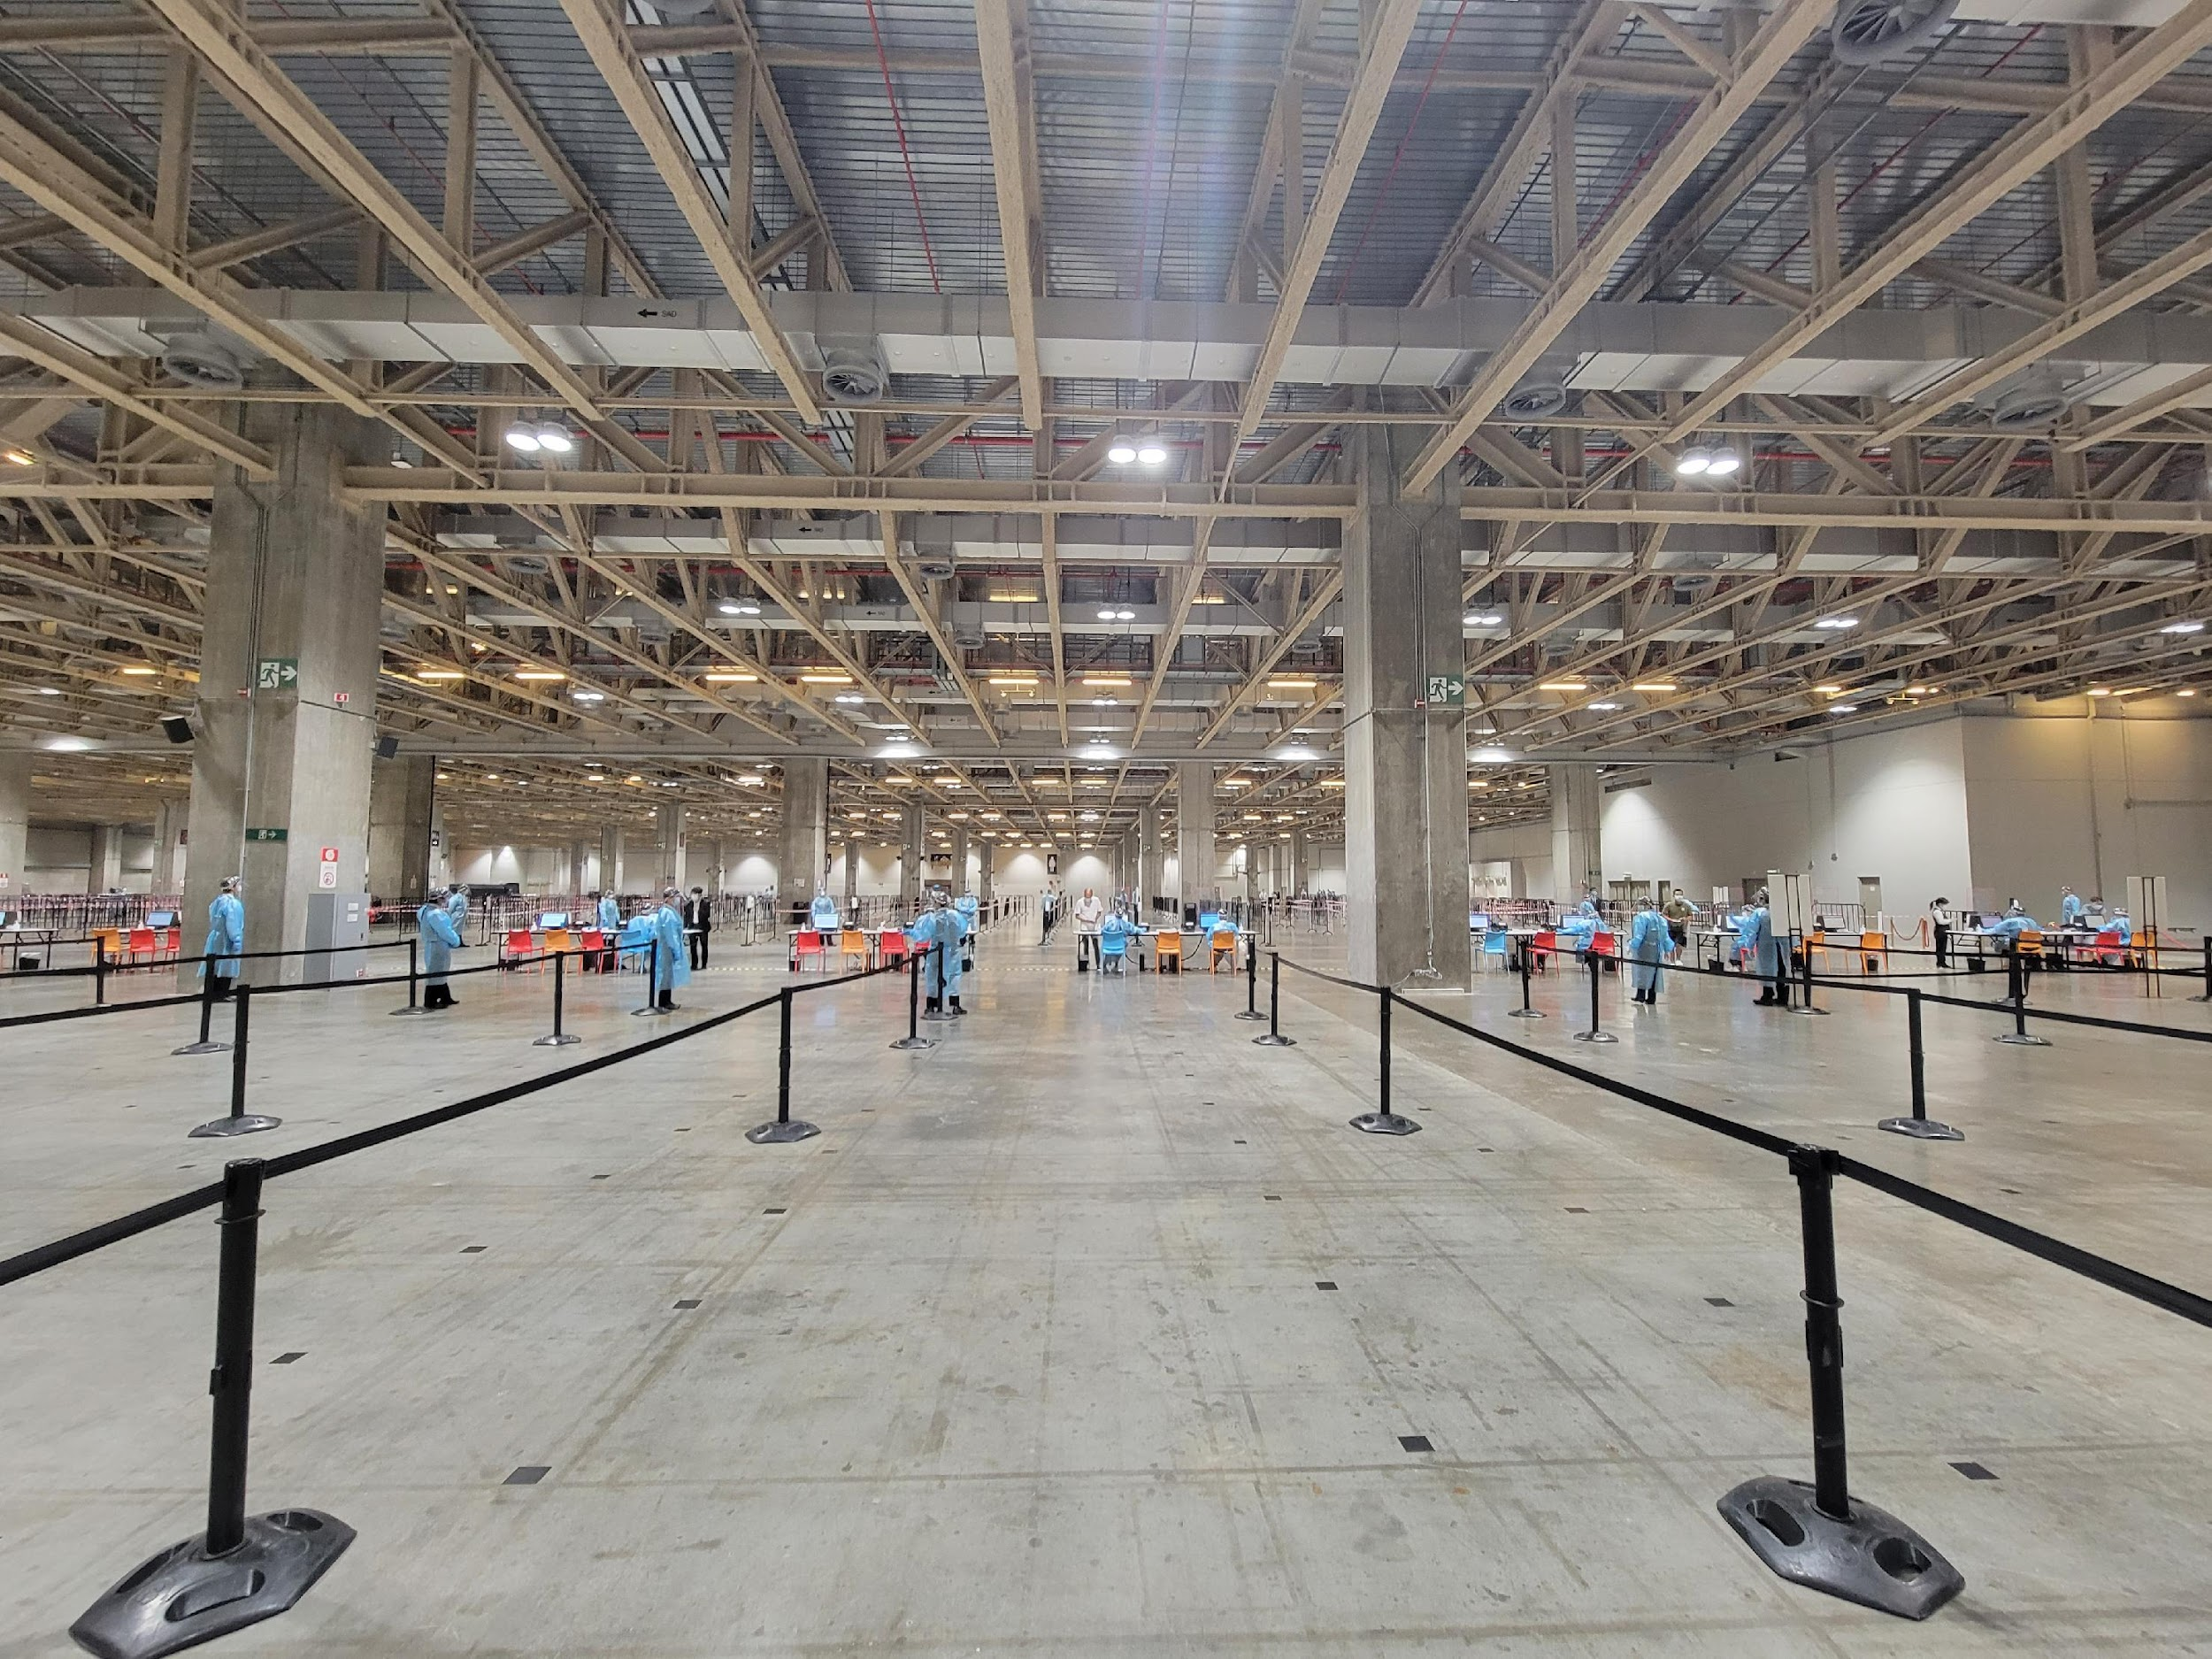
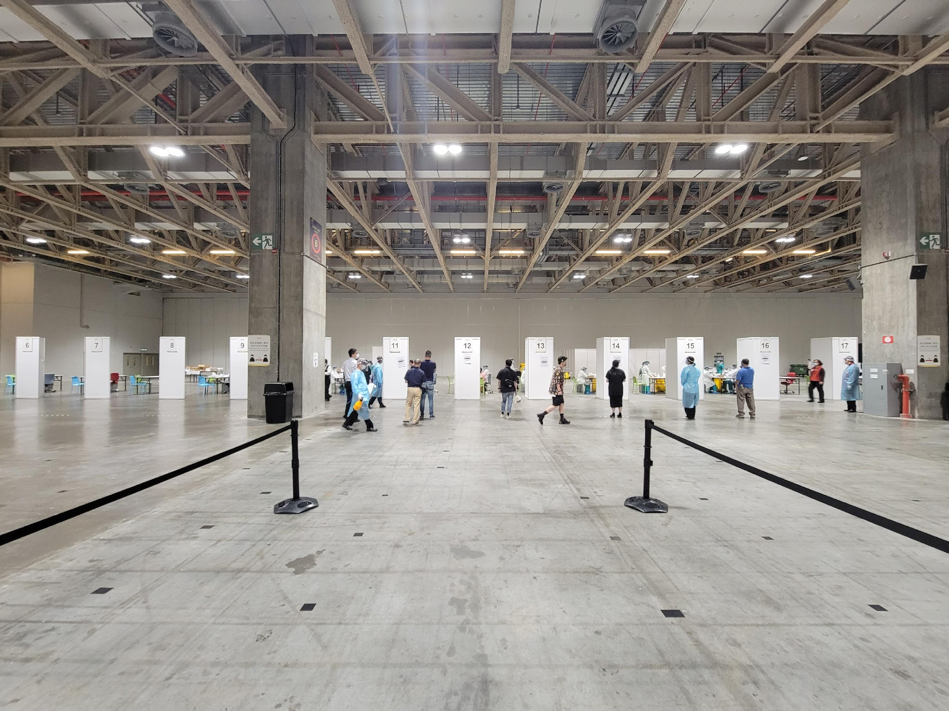
The Fact - 2nd Day At Venetian Cotai Area
- By Venetian Cotai Arena, 2nd day is less stressed comparing to the 1st day - There are about 20 swab stations (desks), by 2nd day noon only 5-6 is operating and there is nearly no waiting queue

Slide 13
Summary
- Swabs per desk as a speed measure can be used to review the load balance to each station, ideally this number is under 33
- Potential improvement for increase the swab station desks during the peak rush hours
- Consider relocating more / less staff depending on the next hour booking numbers
- Limit for upcoming bookings for locations has resource shortage, without needed to relocate staffs
Notes:
8個常規核酸檢測站在全民核酸檢測結束後將重新開放並延長服務時間 今(4)日晚上9時至10月7日晚上9時進行第三次全民核酸檢測 第 3 次較第 2 次全民核檢首 3 小時採樣人數多 各個採樣站點的輪候情況理想

